Slide 1
Project Time Management: Critical Path Analysis

Slide 2
Project Time Management Processes
Activity definition: Identifying the specific activities that the project team members and stakeholders must perform to produce the project deliverables.
Activity sequencing: Identifying and documenting the relationships between project activities.
Activity resource estimating: Estimating how many resources a project team should use to perform project activities.
Activity duration estimating: Estimating the number of work periods that are needed to complete individual activities.
Schedule development: Analyzing activity sequences, activity resource estimates, and activity duration estimates to create the project schedule.
Schedule control: Controlling and managing changes to the project schedule.
UCS 804- Software Project Management

Slide 3
Activity Definition
An activity or task is an element of work normally found on the WBS that has an expected duration, a cost, and resource requirements.
Project schedules grow out of the basic documents that initiate a project.
  The project charter includes start and end dates and budget information.
  The scope statement and WBS help define what will be done.
Activity definition involves developing a more detailed WBS and supporting explanations to understand all the work to be done, so you can develop realistic cost and duration estimates.
UCS 804- Software Project Management

Slide 4
Activity Lists and Attributes
An activity list is a tabulation of activities to be included on a project schedule. The list should include:
  The activity name
  An activity identifier or number
  A brief description of the activity
Activity attributes provide more information about each activity, such as predecessors, successors, logical relationships, leads and lags, resource requirements, constraints, imposed dates, and assumptions related to the activity.
UCS 804- Software Project Management

Slide 5
Milestones
A milestone is a significant event that normally has no duration.
It often takes several activities and a lot of work to complete a milestone.
Milestones are useful tools for setting schedule goals and monitoring progress.
Examples include completion and customer sign-off on key documents and completion of specific products.
UCS 804- Software Project Management

Slide 6
Activity Sequencing
Involves reviewing activities and determining dependencies.
A dependency or relationship relates to the sequencing of project activities or tasks.
You must determine dependencies in order to use critical path analysis.
UCS 804- Software Project Management

Slide 7
Critical Path Analysis
 | Activity |  | duration
 | Shower |  | 3
 | Dry hair |  | 8
 | Fetch car |  | 7
 | Iron clothes |  | 12
 | Dress and make-up |  | 10
 | Drive to interview |  | 20
UCS 804- Software Project Management

Slide 8
Precedence table
The last activities that must be completed before an activity can begin
 | Activity | Immediately preceding activities | duration
A | Shower | - | 3
B | Dry hair | A | 8
C | Fetch car | - | 7
D | Iron clothes | - | 12
E | Dress and make-up | B,D | 10
F | Drive to interview | C,E | 20
UCS 804- Software Project Management

Slide 9
Activity on Arc Network
2
A(3)
B(8)
D(12)
1
3
5
E(10)
F(20)
C(7)
4
UCS 804- Software Project Management

Slide 10
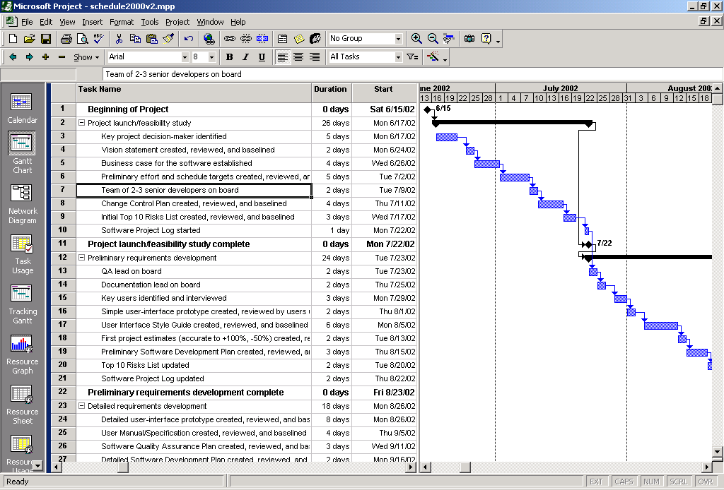
Microsoft Project Example
UCS 804- Software Project Management

Slide 11
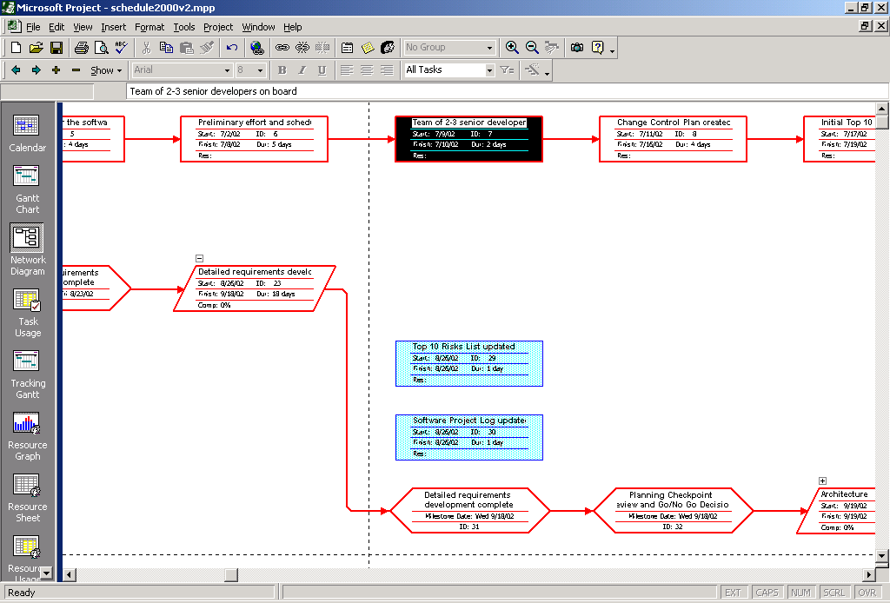
Microsoft Project Example
UCS 804- Software Project Management

Slide 12
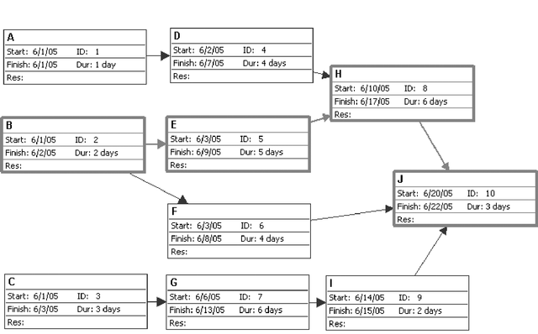
Sample Network Diagram
UCS 804- Software Project Management

Slide 13
Network Diagrams
AOA consists of
    Circles representing Events
      Such as ‘start’ or ‘end’ of a given task
    Lines representing Tasks
      Thing being done ‘Build UI’
    a.k.a. Arrow Diagramming Method (ADM)
AON
    Tasks on Nodes
      Nodes can be circles or rectangles (usually latter)
      Task information written on node
    Arrows are dependencies between tasks
    a.k.a. Precedence Diagramming Method (PDM)
UCS 804- Software Project Management

Slide 14
AOA Project Network for House
3
Lay foundation
Dummy
2
0
Build house
Finish work
1
3
2
1
4
6
7
Design house and obtain financing
Order and receive materials
3
1
1
1
Select paint
Select carpet
5
AON Project Network for House
Lay foundations
Build house
2
4
2
3
Finish work
7
Start
1
1
3
Design house and obtain financing
3
6
1
5
1
1
Select carpet
Order and receive materials
Select paint
UCS 804- Software Project Management

Slide 15
Situations in network diagram
B
A
A must finish before either B or C can start
C
A
C
both A and B must finish before C can start
B
A
C
both A and B must finish before either of C or D can start
B
D
A
B
A must finish before B can start
both A and C must finish before D can start
Dummy
C
D
UCS 804- Software Project Management

Slide 16
Concurrent Activities
3
Lay foundation
Lay
foundation
Dummy
2
3
2
0
1
2
4
Order material
Order material
(a) Incorrect precedence relationship
(b) Correct precedence relationship
UCS 804- Software Project Management

Slide 17
Critical Path Method (CPM)
CPM is a network diagramming technique used to predict total project duration.
A critical path for a project is the series of activities that determines the earliest time by which the project can be completed.
The critical path is the longest path through the network diagram and has the least amount of slack or float.
Slack or float is the amount of time an activity can be delayed without delaying a succeeding activity or the project finish date.
UCS 804- Software Project Management

Slide 18
Forward Pass
Earliest Start Time (ES)
  earliest time an activity can start
  ES = maximum EF of immediate predecessors
Earliest finish time (EF)
  earliest time an activity can finish
  earliest start time plus activity time
    EF= ES + t
Backward Pass
Latest Start Time (LS)
  Latest time an activity can start without delaying critical path time
    LS= LF - t
Latest finish time (LF)
  latest time an activity can be completed without delaying critical path time
  LS = minimum LS of immediate predecessors
UCS 804- Software Project Management

Slide 19
CPM analysis
Draw the CPM network
Analyze the paths through the network
Determine the float for each activity
  Compute the activity’s float
  float = LS - ES = LF - EF
  Float is the maximum amount of time that this activity can be delay in its completion before it becomes a critical activity, i.e., delays completion of the project
Find the critical path is that the sequence of activities and events where there is no “slack” i.e.. Zero slack
  Longest path through a network
Find the project duration is minimum project completion time
UCS 804- Software Project Management

Slide 20
CPM Example:
CPM Network
f, 15
g, 17
h, 9
a, 6
i, 6
b, 8
d, 13
j, 12
c, 5
e, 9
UCS 804- Software Project Management

Slide 21
CPM Example
ES and EF Times
f, 15
g, 17
h, 9
a, 6
0
6
i, 6
b, 8
0
8
d, 13
j, 12
c, 5
0
5
e, 9
UCS 804- Software Project Management

Slide 22
CPM Example
ES and EF Times
f, 15
6
21
g, 17
h, 9
a, 6
0
6
6
23
i, 6
b, 8
0
8
d, 13
j, 12
8
21
c, 5
0
5
e, 9
5
14
UCS 804- Software Project Management

Slide 23
CPM Example
f, 15
ES and EF Times
6
21
g, 17
h, 9
a, 6
21
30
0
6
6
23
i, 6
23
29
b, 8
0
8
d, 13
j, 12
8
21
21
33
c, 5
0
5
e, 9
Project’s EF = 33
5
14
UCS 804- Software Project Management

Slide 24
CPM Example
f, 15
ES and EF Times
6
21
g, 17
h, 9
a, 6
21
30
0
6
6
23
i, 6
23
29
b, 8
0
8
d, 13
j, 12
8
21
21
33
c, 5
0
5
e, 9
Project’s EF = 33
5
14
UCS 804- Software Project Management

Slide 25
CPM Example
LS and LF Times
f, 15
6
21
h, 9
9
24
21
30
a, 6
g, 17
24
33
0
6
6
23
i, 6
4
9
10
27
23
29
b, 8
27
33
0
8
d, 13
j, 12
0
8
8
21
21
33
c, 5
8
21
21
33
0
5
e, 9
7
12
5
14
12
21
UCS 804- Software Project Management

Slide 26
CPM Example
Float or Float
f, 15
6
21
3
h, 9
9
24
21
30
a, 6
g, 17
3
24
33
0
6
6
23
i, 6
3
4
3
9
10
27
23
29
4
b, 8
27
33
0
8
d, 13
j, 12
0
0
8
8
21
21
33
0
0
c, 5
8
21
21
33
0
5
e, 9
7
7
12
5
14
7
12
21
UCS 804- Software Project Management

Slide 27
CPM Example
Critical Path
f, 15
g, 17
h, 9
a, 6
i, 6
b, 8
d, 13
j, 12
c, 5
e, 9
NOTE: All related calculations are shown on Slide 50 onwards.
UCS 804- Software Project Management

